Slide 1

Project: Hush Hush Recruiter
Big Data Programming: Python
By Team 12:
Sanath Haritsa
Aniket Ghetla
Spoorti Basarkod Math
Kshema Iliger
Vandit Bhalla

Slide 2
Problem Statement
Doodle is a famous software company that is in constant need of new developers, senior developers, and solution architects.
Hence, it wishes to automate the recruitment process to get the best potential candidates from the market, while also keeping it “Secretive”.
(Hush! Hush!)
2

Slide 3
User Stories
HR Executive
Recruiter
Candidate
3

Slide 4
User Stories
Recruiter
As a recruiter at Doodle,
I wish to automate the process of candidate selection using an in-house solution for different job roles.
I would like to notify the prospective candidates about the job opportunity.
I would like to get the candidates answers automatically evaluated (using existing neural networks, sonarqube, etc.).
I would like to give feedback to the candidate about the results along with a report.
4

Slide 5
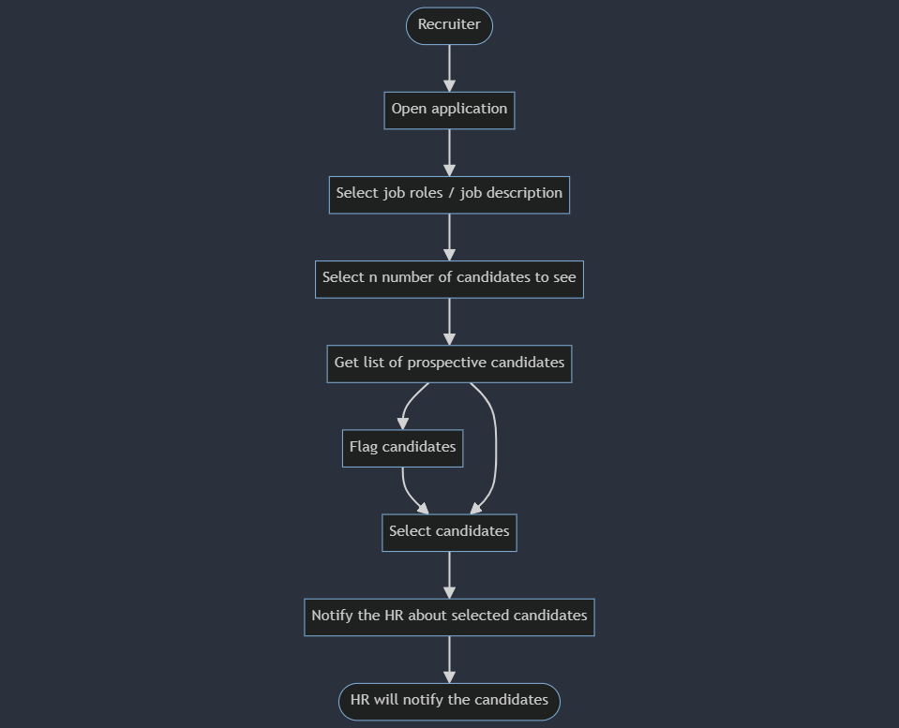
Candidate Selection
5

Slide 6
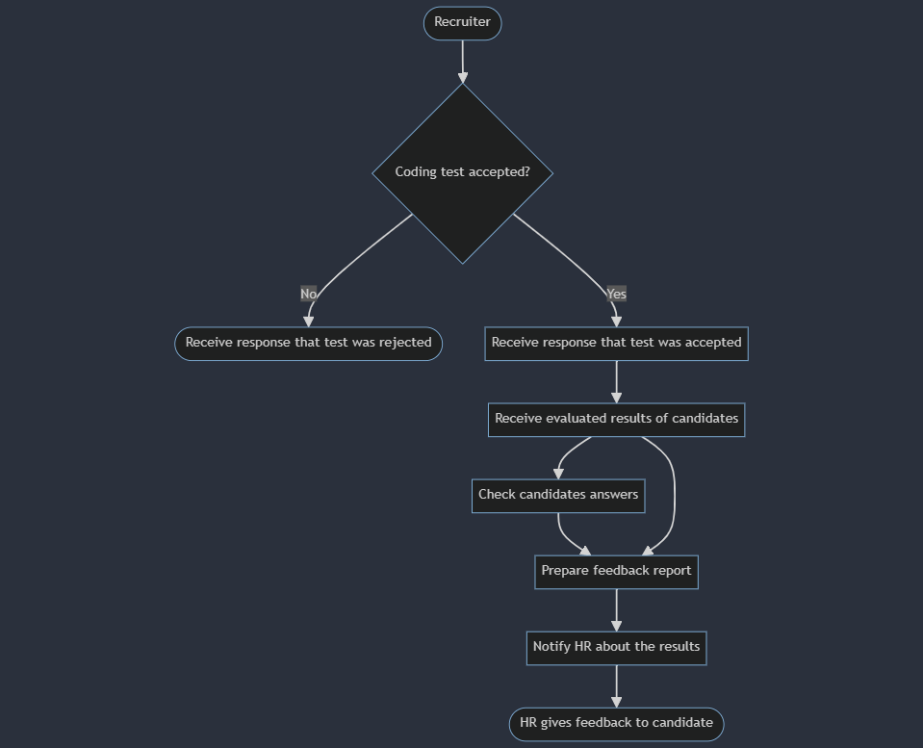
Candidate Evaluation
6

Slide 7
User Stories
Candidate
As a prospective candidate for the job at Doodle,
I wish to get notified when I’m selected for the coding test.
I would like to submit my answers online.
I would like to receive a feedback for the coding test.
I would like to be able to contact the HR if I have any queries.
I would like to see the status of my coding test on the platform.
7

Slide 8
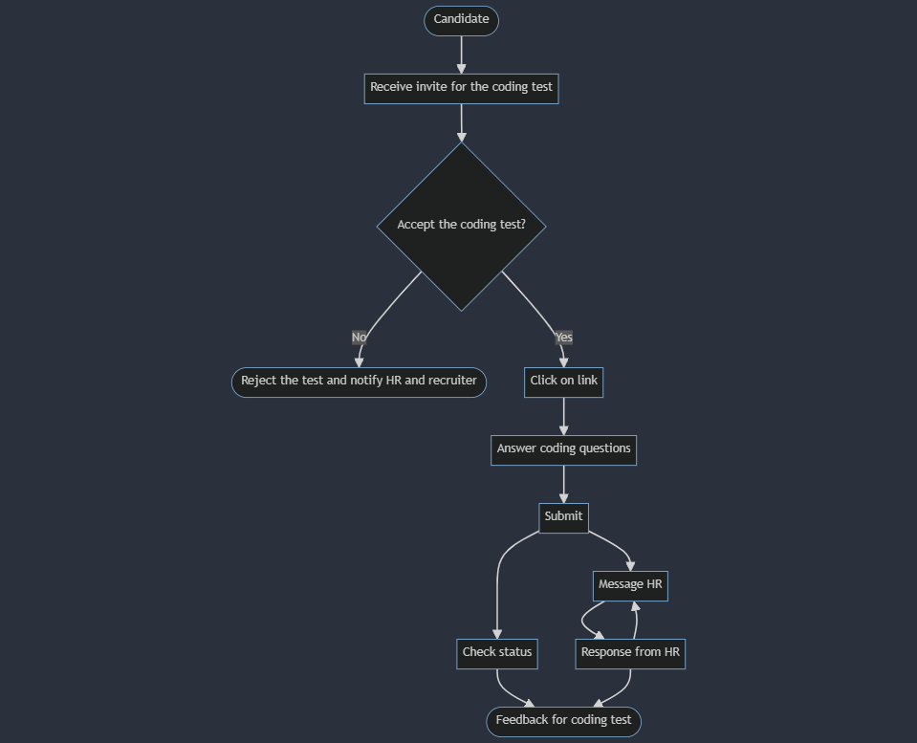
Coding Test
8

Slide 9
User Stories
HR Executive
As a HR Executive at Doodle,
I wish to communicate with the candidate about being selected for the coding test.
I would like to provide feedback to the candidate about the coding test results.
I would like to be able to update the application status on platform.
I would like to be able to communicate with the candidate if they have any queries.
9

Slide 10
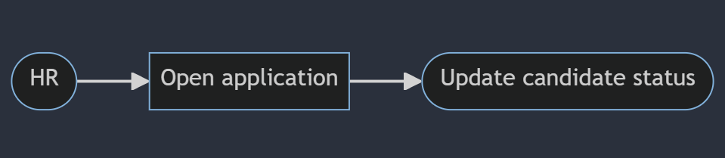
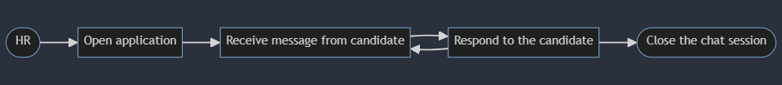
Status Update
Candidate Queries
10

Slide 11
Thanks
11

